Slide 1
Comparison Between Dask & Ray

Slide 2
Outline
What is dask and ray?
Features
Deployment
Clustering
Demo
Performance Measure
Which one to use?

Slide 3
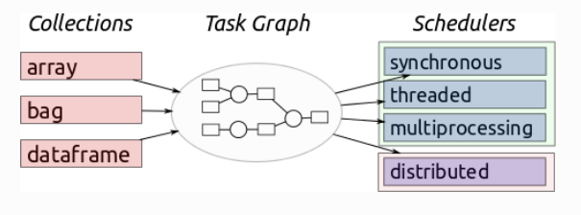
What is Dask?
Dask is a library for parallel computing in Python.
Dask scale pandas and numpy with minimum changes in code format.
Provides ways to scale Scikit-Learn workflows with minimal rewriting.

Slide 4
Working of Dask
Central task scheduler
A set of workers
The scheduler assigns tasks to the workers. Each worker is assigned a number of cores on which it can perform computations.
How a conversation between a scheduler and workers looks like?
Central task scheduler sends jobs (python functions) to lots of worker processes, either on the same machine or on a cluster:
Worker A, please compute x = f(1), Worker B please compute y = g(2)
Worker A, when g(2) is done please get y from Worker B and compute z = h(x, y)

Slide 5
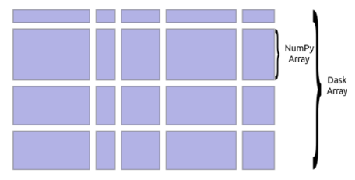
Dask Array
A number of numpy arrays are arranged into grids to form a Dask array.
Important features :
Parallel: Dask arrays use all the cores of the system
Larger-than-memory: Enables working on datasets that are larger than the memory available on the system
Dask arrays support most of the numpy functions. Eg. .sum(), .mean()

Slide 6
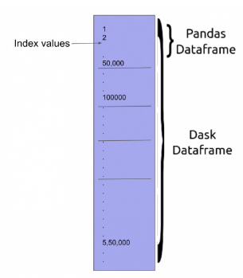
Dask Dataframe
Dask dataframe consists of multiple smaller pandas dataframes.
APIs offered by the Dask dataframe are very similar to that of the pandas dataframe.

Slide 7
What is Ray?
Ray is a framework for building and running distributed applications.
Compute on objects
Remote objects are stored in object stores, and there is one object store per node in the cluster

Slide 8
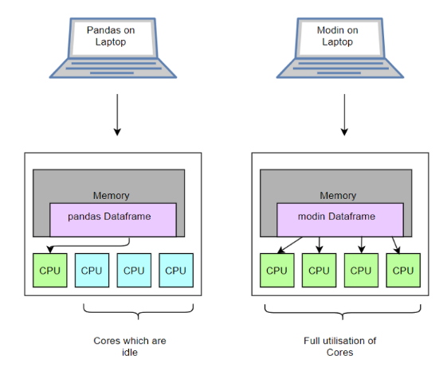

Slide 9
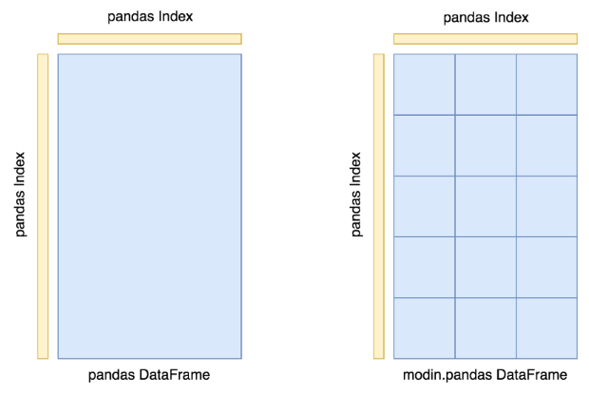
Ray : modin.pandas library

Slide 10
Dask Features
Runs on clusters with 1000s of cores
A real-time and responsive dashboard that shows current progress, memory use, and more, updated every 100ms
Dask works with GPUs
Parallelize Scikit-Learn Directly .Dask extends this parallelism to many machines in a cluster.
Parallelize XGBoost or Tensorflow.

Slide 11
Ray Features
Accelerate deep learning and reinforcement learning development
Launch a Ray cluster, either privately, on AWS, or on GCP
The Ray backend includes built-in support for CPUs and GPUs.
Deploying on Kubernetes (not been tested extensively.)

Slide 12
Conclusion - Dask vs Ray
Dask
for parallel/distributed Python
Dask uses a centralized scheduler
Latency to submit a task and get the result is about 30x faster.
Dask has extensive high-level collections APIs
Custom task graph
Ray
for parallel/distributed Python
Ray uses a distributed scheduling scheme to allow high task throughput
Focused more on libraries for machine learning and reinforcement learning.
Less number of API implemented from Pandas
Similarity
Difference

Slide 13
Scalable Machine Learning
Dask-Ml Library:
Preprocessing
Cross-Validation
Hyperparameter Search
Pipelines and Composite Estimators
Clustering
XGBoost
Tensorflow
Generalized Linear Models
Dask
Scaling Scikit-Learn
Training on Large Datasets
Integrations with Other Libraries

Slide 14
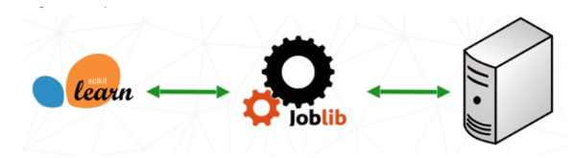
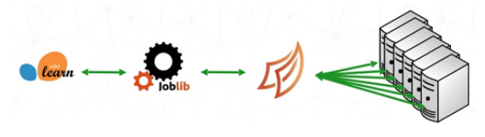
Joblib is a library in python that provides support for parallelization
Dask

Slide 15
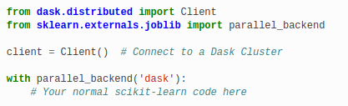
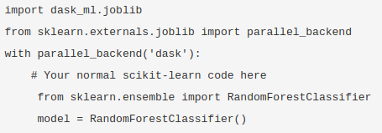
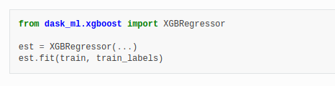
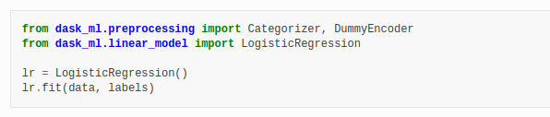
ML - Dask
Parallelize Scikit-Learn Directly
Partner with other distributed libraries

Slide 16
Cluster Deployment with Dask
Cluster with Kubernetes in Google Cloud, AWS or MS Azure
Docker image that contains requirements and code
Dask has two families of task schedulers
Single machine scheduler: It can only be used on a single machine and does not scale.
Distributed scheduler: It can run locally or distributed across a cluster.
Deploy Dask on YARN clusters
Deploying Dask on high performance supercomputers
Deploy Jupyter on common cloud providers like Amazon, Google, or Microsoft Azure

Slide 17
Pros and Cons
Dask |  | Ray
Pros | Cons | Pros | Cons
More general for parallelizing work | Centralized scheduler | Ray uses a sharded database (implemented as multiple Redis servers), to store the metadata and control state of the system. | support ~71% of the pandas API.
Useful DatetimeIndex operation(floor, ceiling, round) |  | Worker processes can access objects in the object store through shared memory with minimal deserialization (and without copying the data). | Defaulting to pandas (first convert to a pandas DataFrame)
Large subset of Pandas API (filtering, grouping, joining) |  |  | Specific to RL, tuning (don’t support all ml workflows)
 |  |  | Modin.pandas is very difficult to run on cluster
Scale to 1000s of core |  |  | Work well for small cluster

Slide 18
Performance - Pandas/Dask/Ray
Total Records | Operation | Dask timings | Ray timings | Without Dask/Ray
(550068,12) (25.5MB csv file) | .read_csv | 22.7 ms | 5.81 s | 805 ms
 | .head() | 633 ms | 380 ms | 31 ms
 | .groupby() | 656 ms | 25.7 s (Default to Pandas) | 46 ms
(3421083, 7) (109 MB csv file) | .read_csv | 169 ms | 1.66 s | 1.74 s
 | .head() | 2.25 s | 104 ms | 28.7 ms
 | .groupby() | 1.93 s | 660 ms (default to pandas) | 190 ms
Ubuntu 16.04, 4 core, intel i5, 4GB RAM, 1TB HardDisk (dual booted)

Slide 19
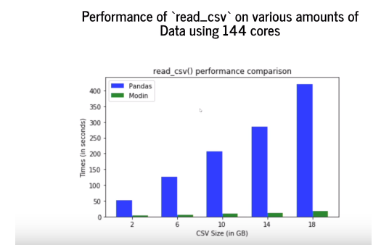

Slide 20
Performance - On Cluster
Sklearn svm model- hyperparameter tuning
 | Single Machine (Multiprocessing) | Cluster (1 Node)
Without Dask & Ray (using only sklearn joblib, n_jobs=-1) | 8.68 sec (using all 4 core) | Not possible to use cluster
Dask | 6.63 sec | 5.63 sec
Ray | 7 sec | -------
Ubuntu 16.04, 4 core, intel i5, 4GB RAM, 1TB HardDisk (dual booted)

Slide 21
Performance - Cluster
Time taken to execute (5X10⁸ ) loops in python program
Ubuntu 16.04, 4 core, intel i5, 4GB RAM, 1TB HardDisk (dual booted)
 | Single Machine (Multiprocessing) | Cluster (1 Node)
Without Dask & Ray | No Multiprocessing (7. 87 sec) | -----
Dask | 5.59 sec | 4.32 sec
Ray | 4.98 sec | 2.47 sec

Slide 22
Other Dev Considerations….
There will be overhead if there is no api implemented in Ray for Pandas api, default to pandas
Dask and Ray works better if time of execution is in order of minute

Slide 23
Which one to Use?
Dask:
More documented
Custom task graph
More Pandas API implemented
All ml workflows are can be implemented in Parallel in cluster

Slide 24
Quick Demo
Setting up on same laptop for multiprocessing
Large dataset loading and working with it
ML model hyperparameter optimisation, feature engineering, RL etc.
Pipelining in Dask (Custom Graph)
Performance comparison on Numpy and Pandas
Time Series

